Slide 1

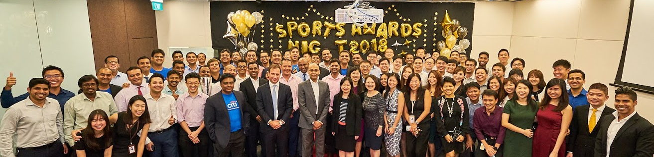

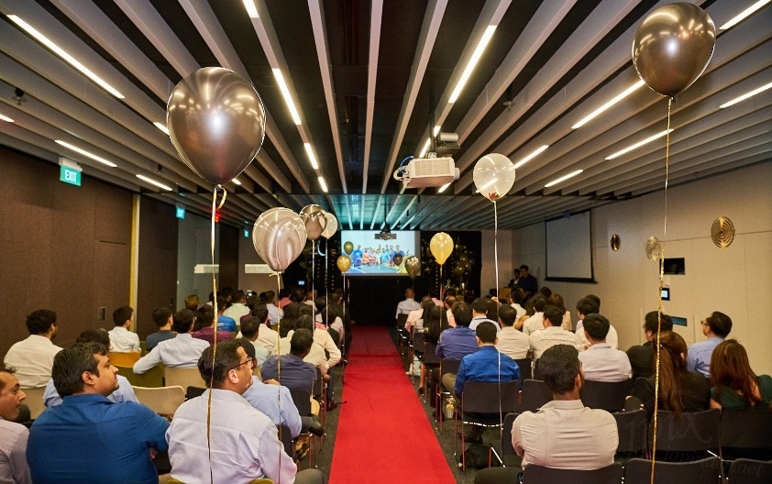

Appreciating our champions
Sports Awards Night 2018
On 2nd April, CitiClub Sports organized the Sports Awards Night 2018. This event was one of the highly anticipated event for CitiClub Sports as it was the day where all sports members will gather together and celebrate their achievements and contributions together not just as an individual sports, but as CitiClub Sports. We were honored to have Mr Amol Gupte and many others senior managements to join us in celebrating our sportsman’s achievements and contributions.

